Slide 1
External Communications Working Group
Molly E Brown, NASA GSFC
with WG team

Slide 2
Objectives
Create materials for the carbon.nasa.gov website to communicate the products, science and impact that CMS has had during its existence
Find ways to broaden and strengthen the knowledge of CMS research and increase the engagement with the broader user community
Ensure the community understands the nature, quality and utility of NASA CMS science information and data products

Slide 3
Activity
Last year’s WG held telecons with ST members, had discussions on website users, multimedia content, public outreach, and created a web plan
We started where they left off, working with Peter Griffith’s web team to:
Understand the database behind the website content
Plan how to add additional information to database to achieve website goals
Work to implement the website vision

Slide 4
Website Considerations
Previous efforts focused on developing a new website structure that was more transparent from the user perspective, and defining a mission statement for CMS
New website structure required large amounts of additional material that did not exist, as well as a significant database restructuring
In the last year, we’ve been working to gather the necessary material to do some of the restructuring of the database and add new material
The new website structure has been more problematic

Slide 5
Current Project Focus
Carbon.nasa.gov is focused on the PI name and their project title
CMS funded projects are extremely diverse
Some develop new models and basic research needed to improve the science
Some develop new data products through models, algorithms, campaigns, and ground validation
Some develop tools, methods or evaluate success of an approach to measure carbon
Some have mature products ready for decision support
All vary in their objectives, temporal and spatial resolution and degree of readiness to be used by decision makers

Slide 6
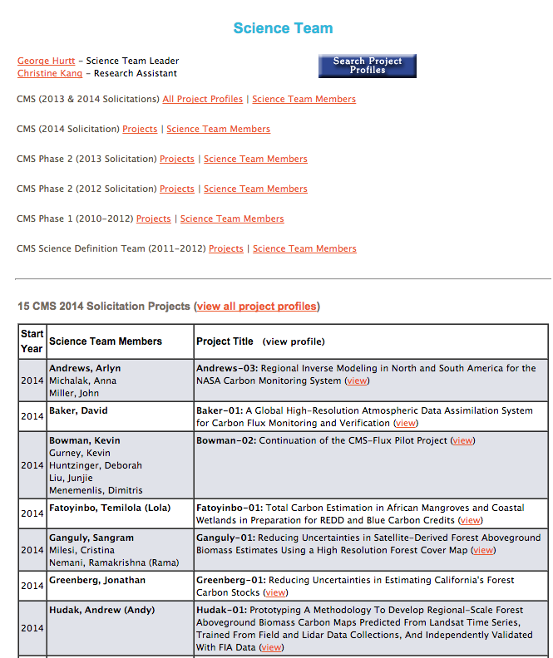
Project Focus
From the USER perspective, this doesn’t make much sense
Our objective is to provide a Product focus so that a user can come to the website and find a CMS product that meets their needs

Slide 7
Projects, Products, and ARLs
We’ve worked to add new information on what each PI will be developing that could be used for decision making
New product keywords have been developed that allow for grouping of different types of products together
Gathering information on each data product or tool each PI will provide
Spatial extent (global, regional, local…)
Spatial Resolution (one degree, one kilometer…)
Time domain (year range, one time snapshot…)
Planned or actual applications readiness level (ARL) for each product, so users can find mature products easily
ARLs reflect the three reflects three main tiers of project research, development, and deployment. ARLs 1-3 encompass discovery and feasibility; ARLs 4-6 address development, testing, and validation; and ARLs 7-9 focus on integration of the “application” into an end-user’s decision-making activity.

Slide 8
Definition of a Product
Any concrete output of a project
Can be DATA PRODUCTS (e.g. maps, statistical estimates)
Can be METHODOLOGIES (innovative approach or improvements on already existing)
Can be EVALUATIONS (e.g. comparison studies, economic analyses)
Can be UNCERTAINTIES (maps, statistics, analyses)
Can be DATA PORTALS or VISUALIZATION TOOLS

Slide 9
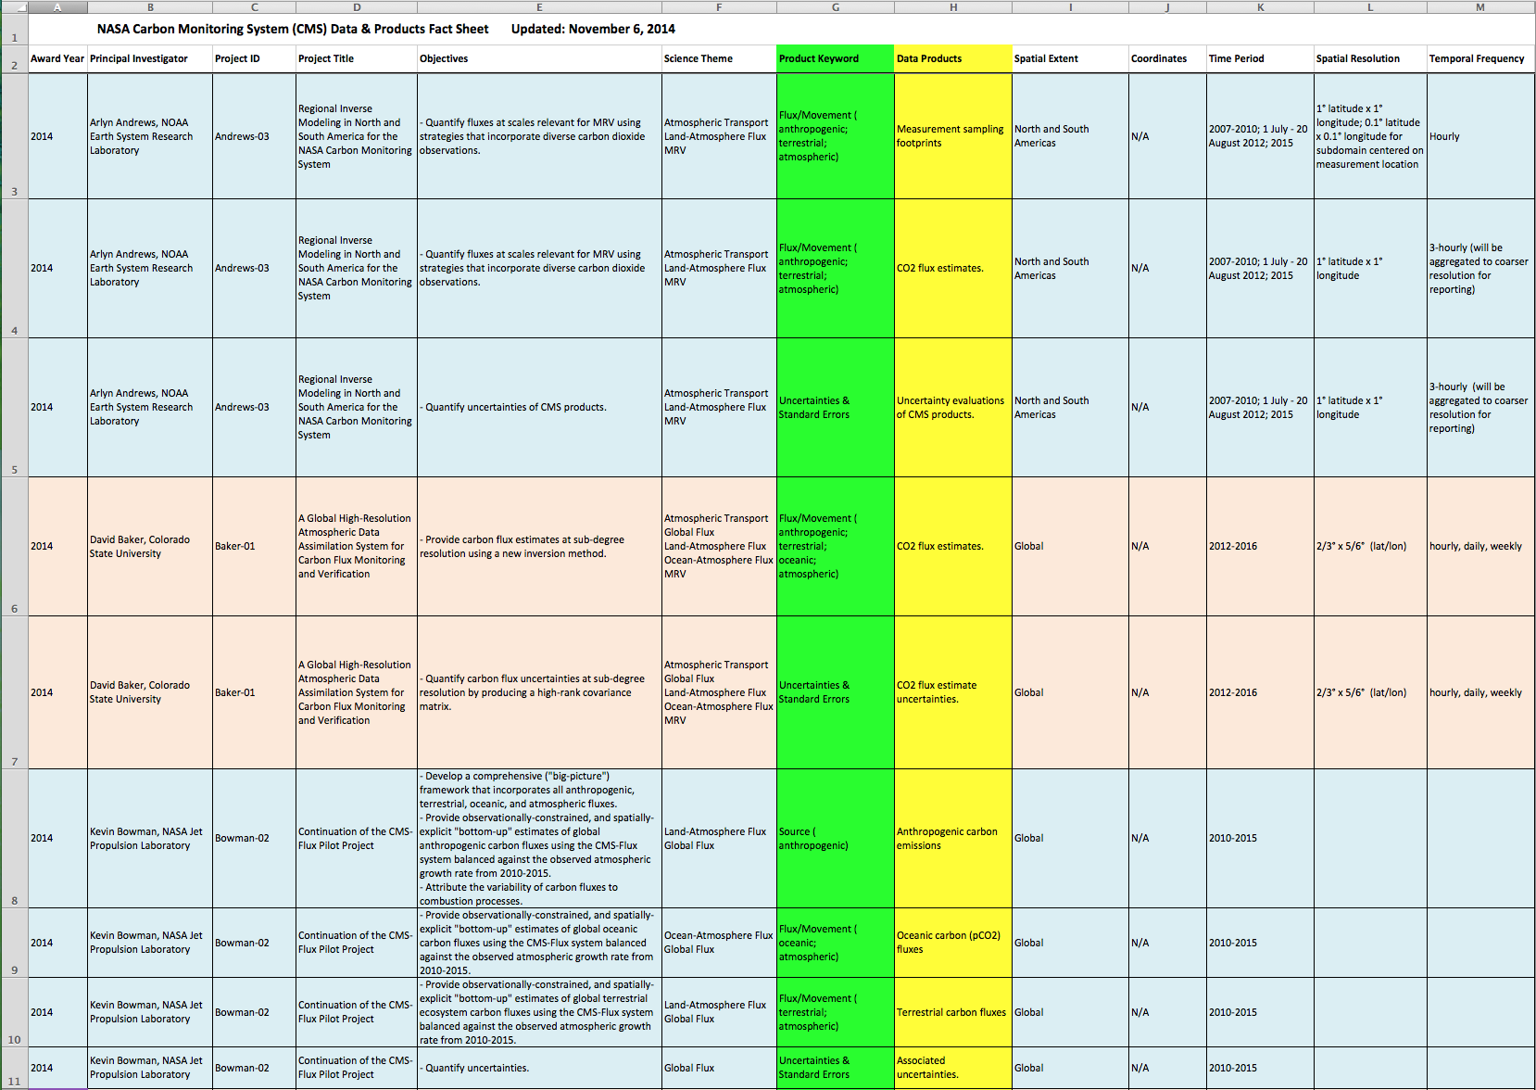
Adding a Product orientation
Existing website will continue, we are adding new ways to sort the information

Slide 10
Future Work
Need for the website:
Clear explanations of science themes (ocean-atmosphere flux, land biomass, atmospheric transport, etc.)
Descriptions of products (sink, flux/movement, etc)
Identification of products that are ongoing and those that were produced just once
Exposure of website to stakeholders and revision, reiteration of content to increase its usefulness and clarity to these groups, while maintaining its function for the Science Team
Interaction with Data WG

Slide 11
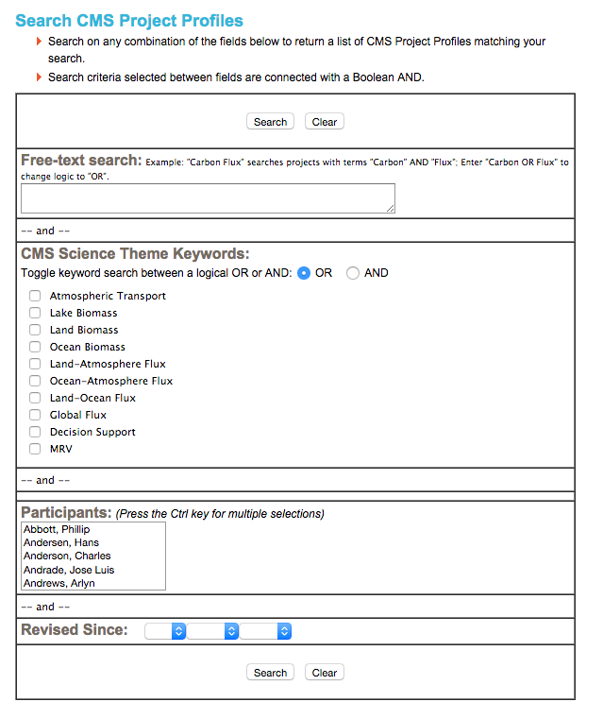
New ‘Search Available Products’ page coming soon

